Slide 1









A Holistic Introduction to DMF for D365FO Implementations
Nathan Clouse
MVP I Technical Architect
Armanino
Alireza Eshaghzadeh
MVP I Senior Business Consultant
Knowit

Slide 2

Data Management Framework
DMF
Data migration
Integration
Power BI
Configurations
Apps
DMF can be used to import, export, and copy data into legal entities. DMF is purposefully designed to assist data migration in D365FO. DMF Can be used to import, export, copy data (setup and configurations) across legal entities, and integration. This can be used for high volume of data since it is compatible to be run through batch job.
Notes:
Data Management Framework can be used to import, export, and copy data into legal entities. DMF is purposefully designed to assist data migration in D365FO. DMF Can be used to import, export, copy data (setup and configurations) across legal entities, and integration. This can be used for high volume of data since it is compatible to be run through batch job.
Data management framework (DMF) is a tool used to manage data entities and data entity packages in Dynamics 365 F&O. It is used as a reliable and accurate source for data migration, integration and setup/copy configurations.

Slide 3
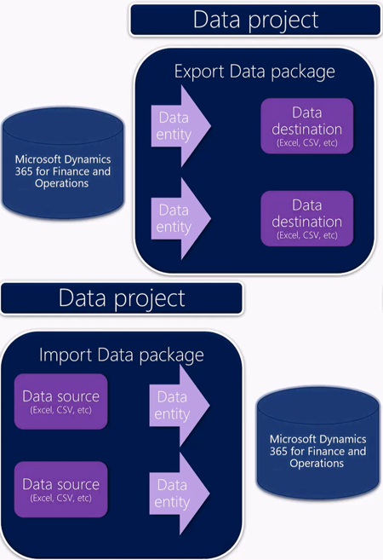

Data management framework
It is a useful tool to quickly migrate reference, master and document data from external systems to D365FO. DMF consists of the following concepts:
Data entities
Data package
Data project

Slide 4


Import / Export / Copy
Export / Import / Copy into legal entity
Templates
Filter
Mapping
Add criteria
Remove map for entity field(s)
Data Management
Import / Export
Data Projects
Job History
Configure entity to export to database /BYOD /Change tracking(Primary, Entire, Custom)
Recurring integrations
Sequencing
Data entities with a data package
Default
Custom
Golden Config
Module
Priority
Data Entities
Template
Dual-write
Notes:
Anatomy of DMF
Describe an in-depth exploration of the structure and components of the framework.

Slide 5
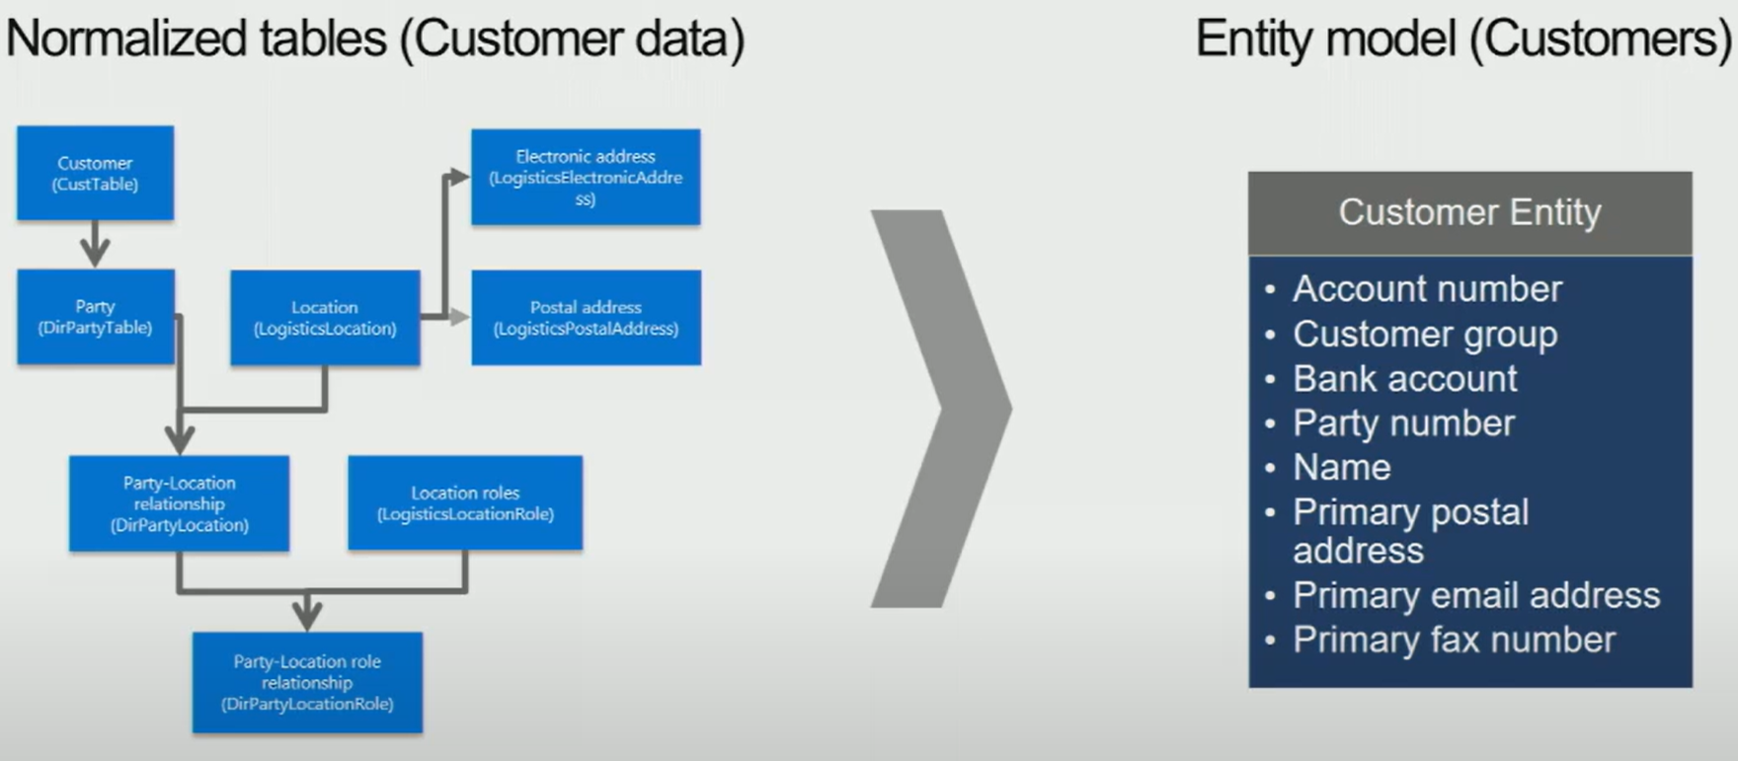
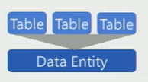
Data Entity
A data entity can be one or multiple tables enabling abstraction of internal interaction between tables.
Source: Microsoft

Slide 6
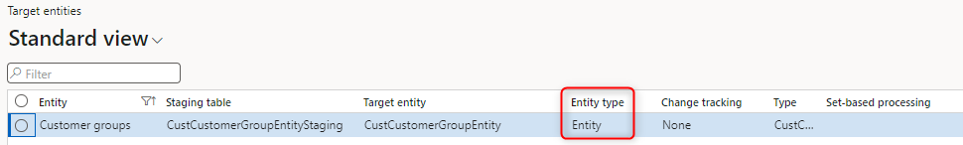
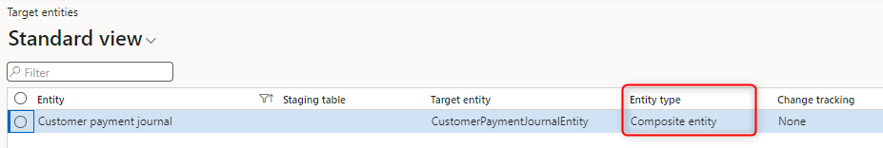

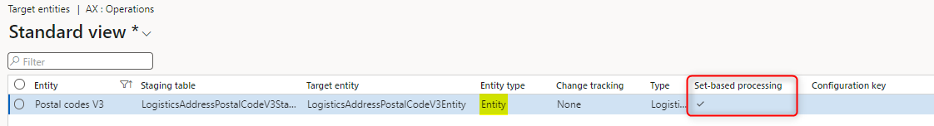
Entity Types
Simple entity: A basic data entity that represents a single concept or entity in the system.
Composite entity: It combines multiple related entities into a single entity
Set based entity: It is collection or set of records that share common characteristics or attributes. It enables operations and actions to be performed on a group of records simultaneously, improving efficiency and scalability in data processing.
Notes:
Composite = xml attribute Set-based database operations will only be enabled when the support set-based SQL operation is set to yes and the enable set-based SQL operations is set to auto.
Views
Unions
Time-State Enabled
Temporary or TempDB
Mixed SaveDataPerCompany
Fields in AK(Alternate Key) not mapped in entity
Aggregations
Composite Data Sources
Joins other than inner and outer join.

Slide 7
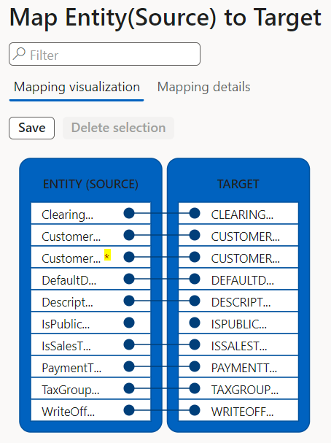
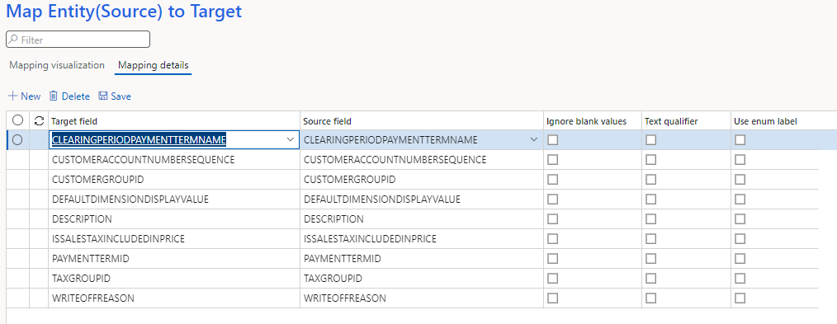
Entity Mapping

Slide 8
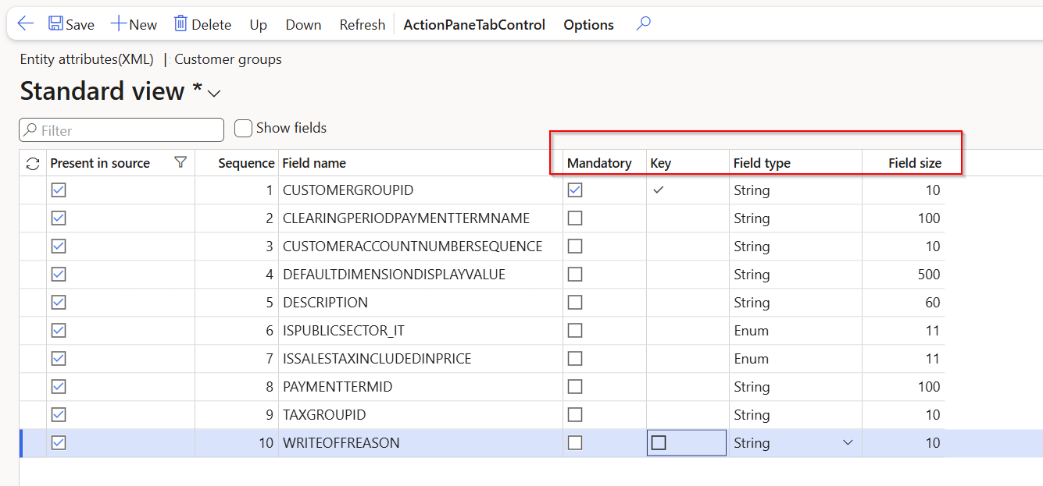
Entity Attributes

Slide 9
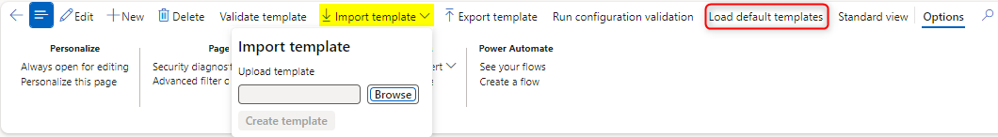
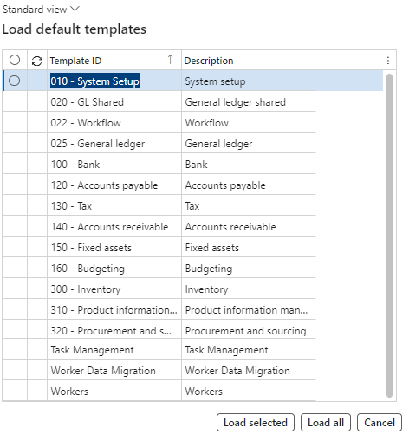
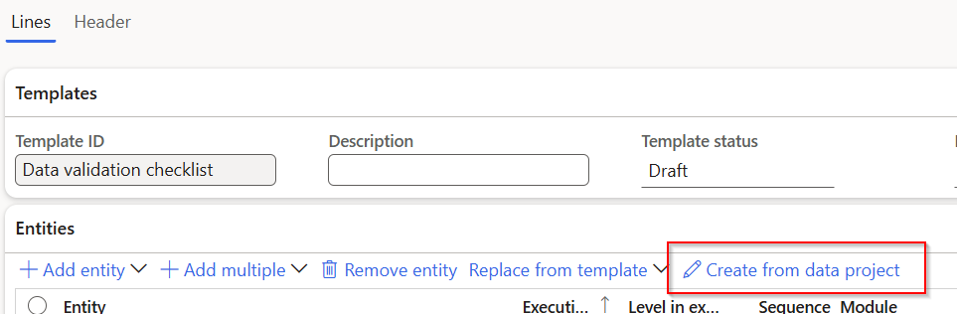
Template

Slide 10
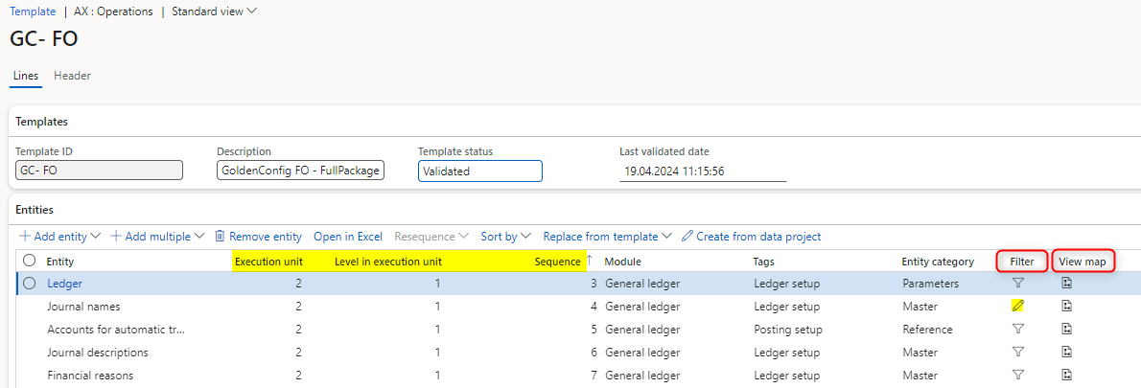
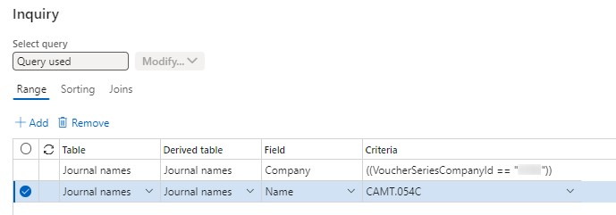
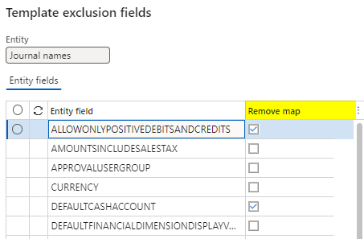
Sequence Filter Mapping

Slide 11
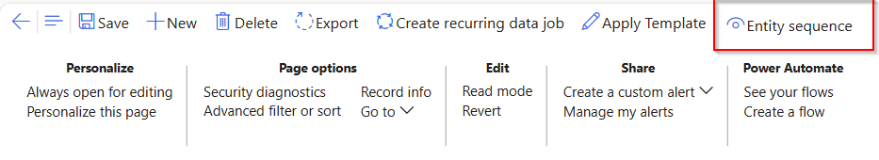
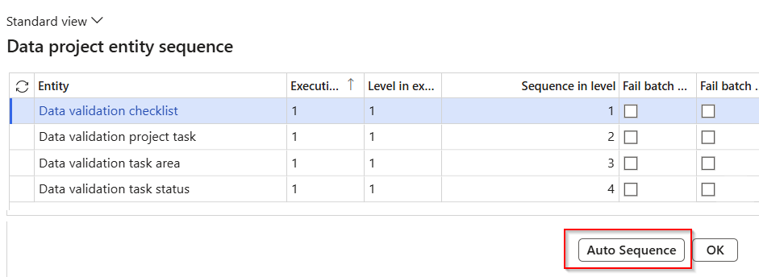
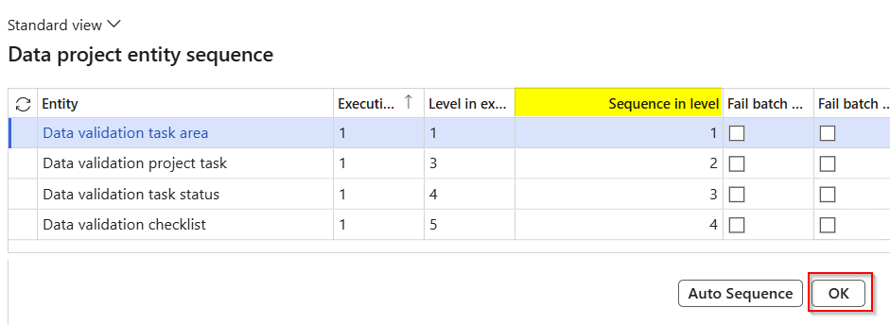
Auto Sequence

Slide 12
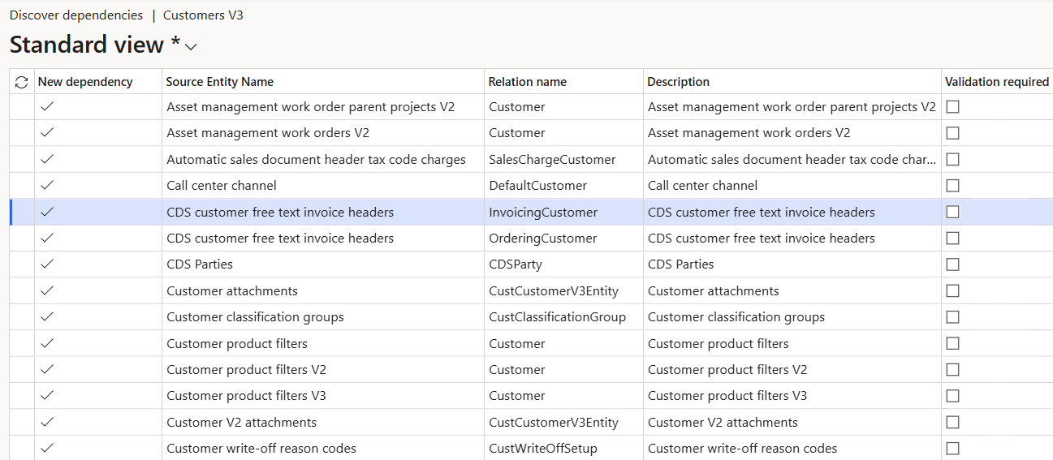
Dependency (ies)

Slide 13
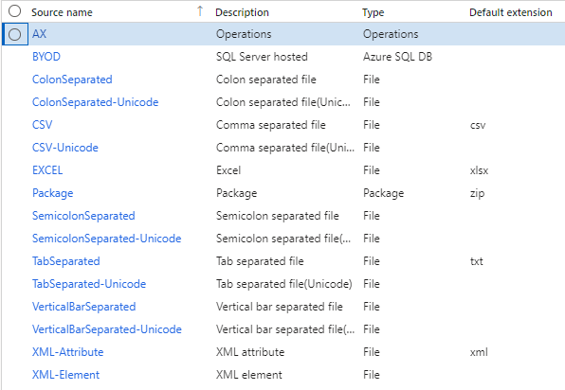
Source data formats

Slide 14
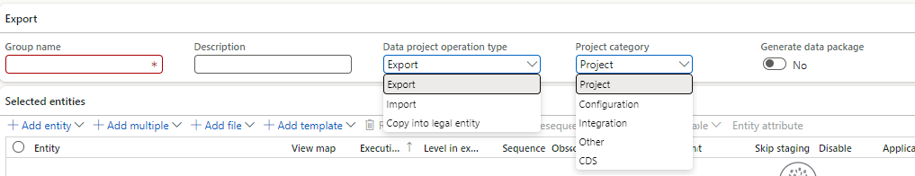
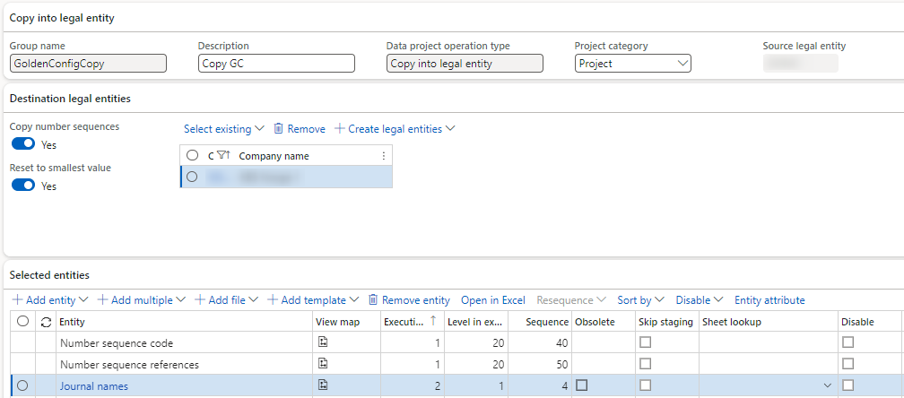
Export Import Copy

Slide 15
Source Staging Target
Methods
2
Staging
Target
Source
1
Source to staging
Staging to target

Slide 16
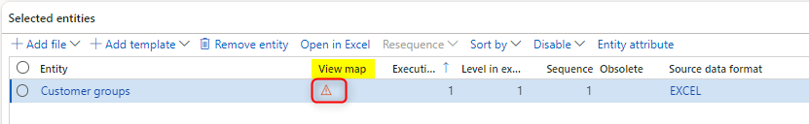
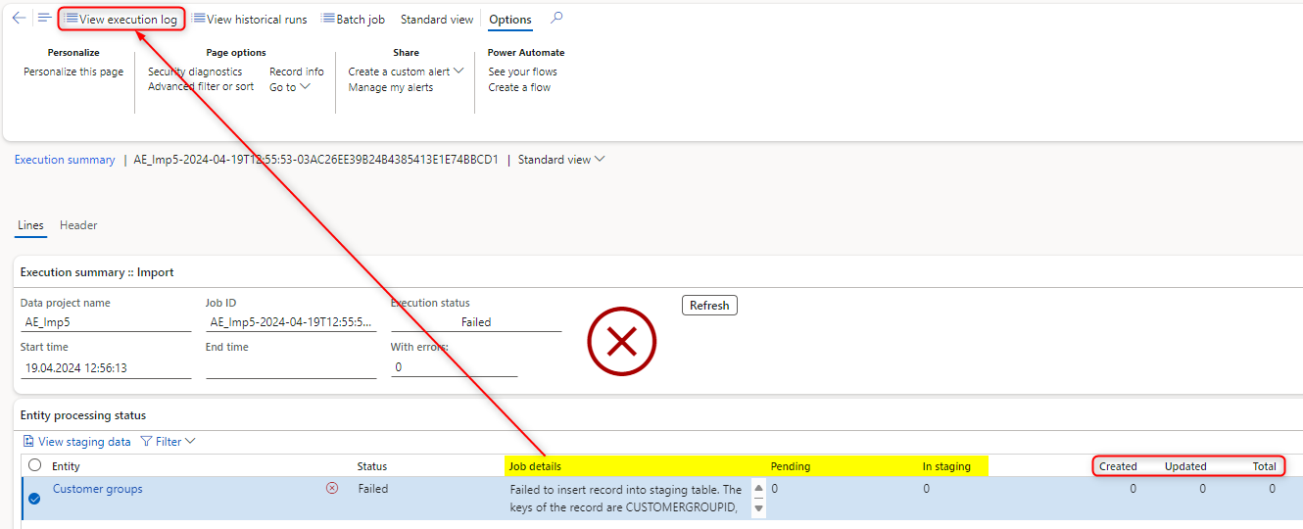
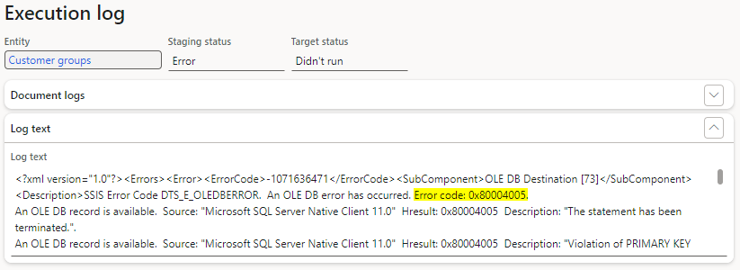
Troubleshoot Error Messages (Import-Staging)
The template file for import has either incorrect format configuration: Staging = No Target = No
Notes:
Microsoft Community Forum

Slide 17
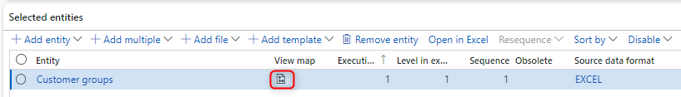
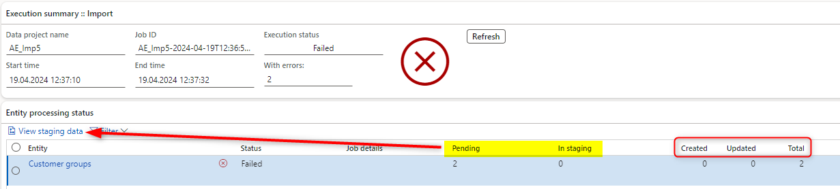
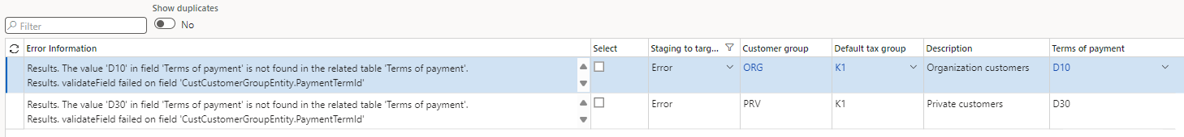
Troubleshoot Error Messages (Import-Target)
The template file for import has incorrect values regarding the D365FO configuration: Staging = Yes Target = No

Slide 18
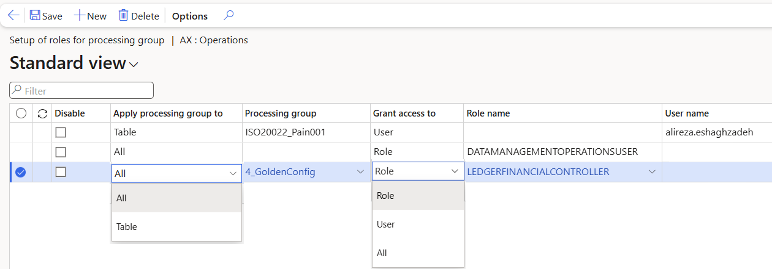
Setup of roles for processing group

Slide 19

Integration
Synchronous: Data entities allow for the exposure of public application programming interfaces (APIs) on entities, facilitating synchronous services. These synchronous services serve various purposes, including Office integration and third-party mobile applications. Synchronous integrations stand out for their ability to provide real-time data exchanges.
Asynchronous: It is designed for scenarios where an immediate response isn't critical, primarily focusing on handling large volumes of data. Some examples include interactive file-based import/export and recurring integrations via files or queues.
Notes:
Ref: TechTalk Integration patterns finance and operations apps - Dynamics 365 | Microsoft Learn

Slide 20
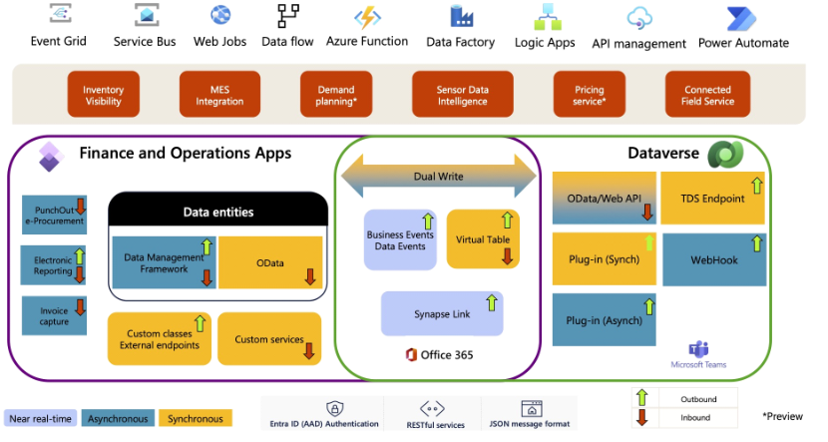
Integration components
Reference: TechTalk Integration patterns finance and operations apps - Dynamics 365 | Microsoft Learn

Slide 21
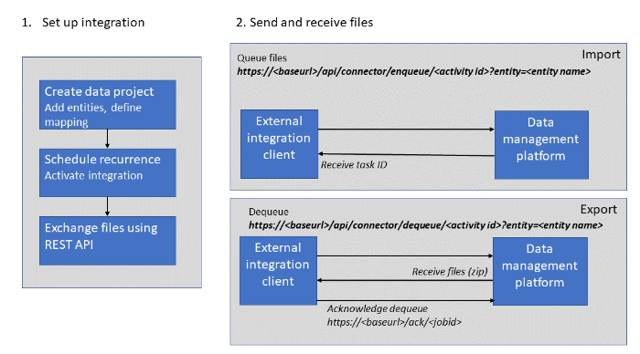
Recurring integrations
Reference: Recurring integrations - Finance & Operations | Dynamics 365 | Microsoft Learn
Notes:
https://www.atomicax.com/blog-entry/how-use-recurring-integration-endpoint-import-data

Slide 22
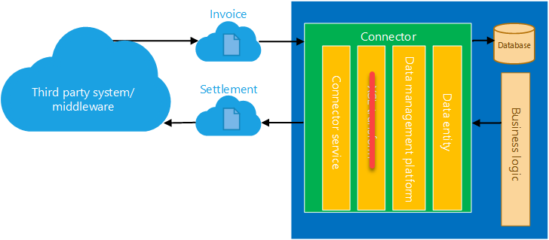

Slide 23
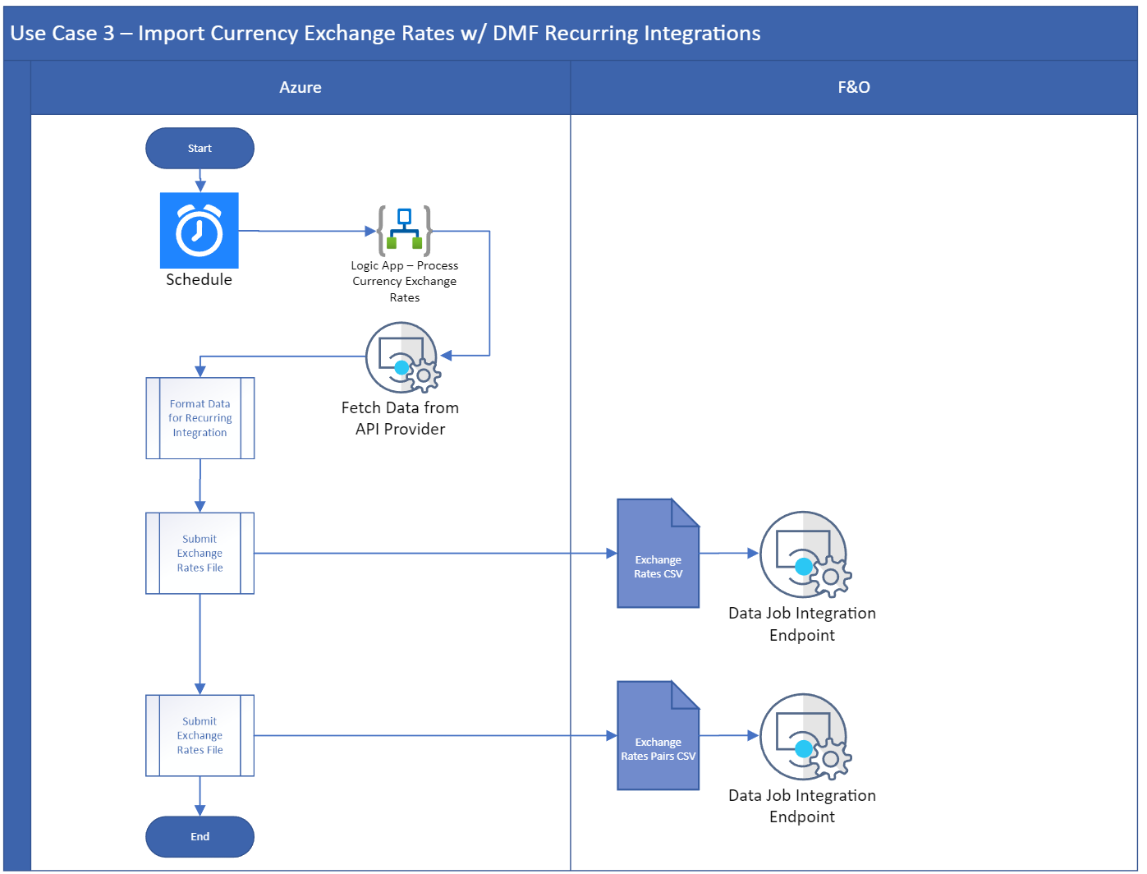

Slide 24
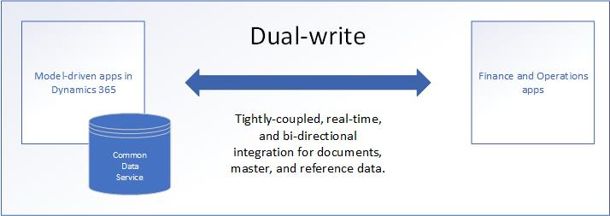
Dual-write
Reference: Dual-write overview - Finance & Operations | Dynamics 365 | Microsoft Learn
Notes:
Dual-write is an out-of-box infrastructure that provides near-real-time interaction between customer engagement apps and finance and operations apps.

Slide 25
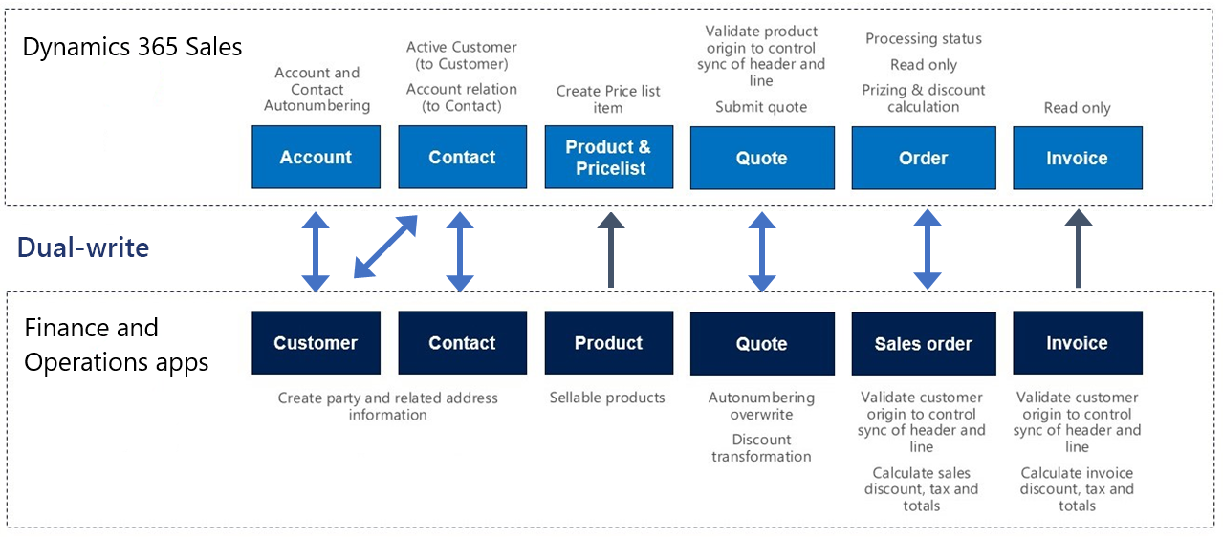

Slide 26
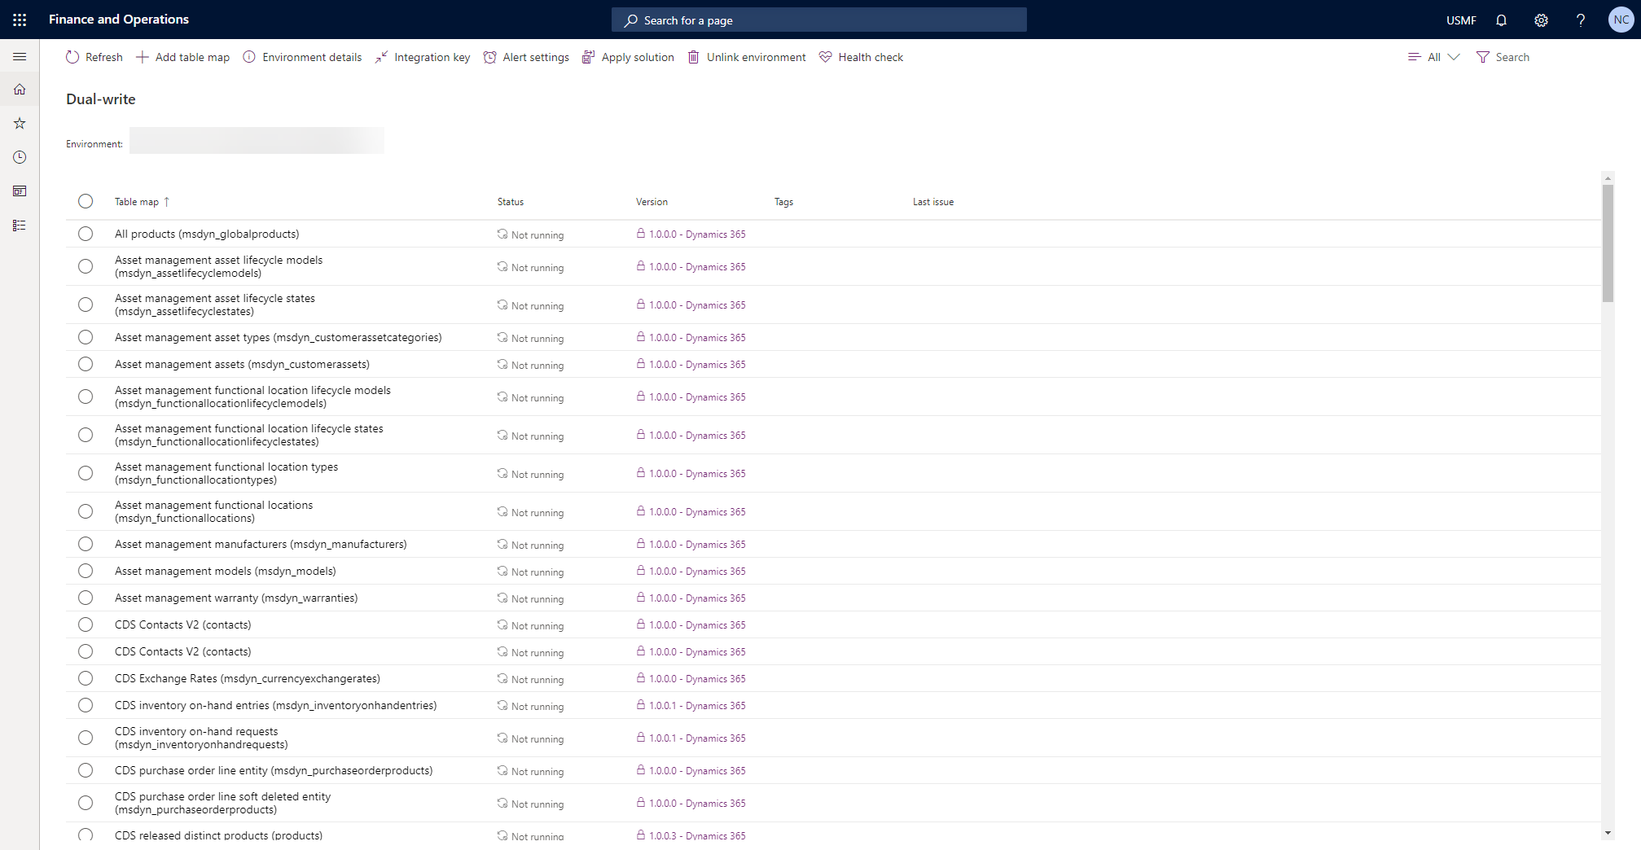

Slide 27
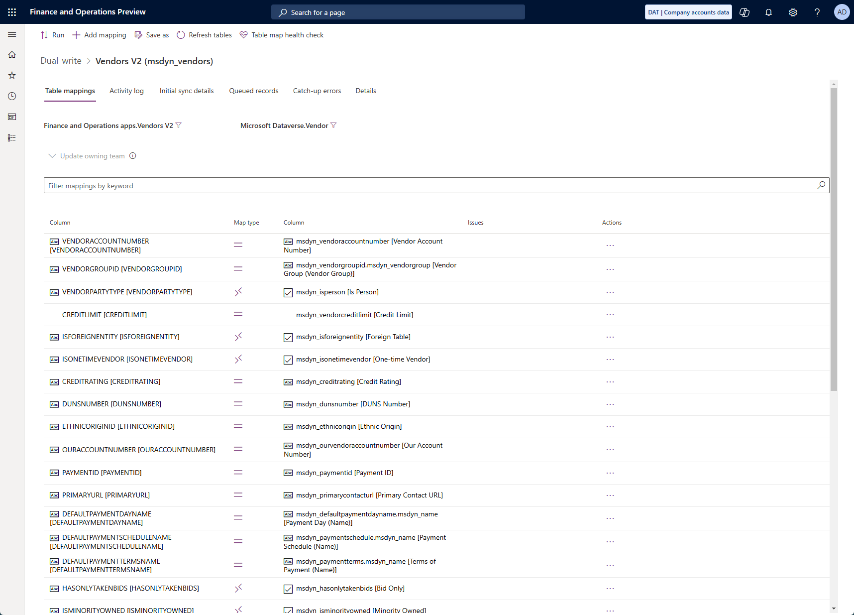

Slide 28
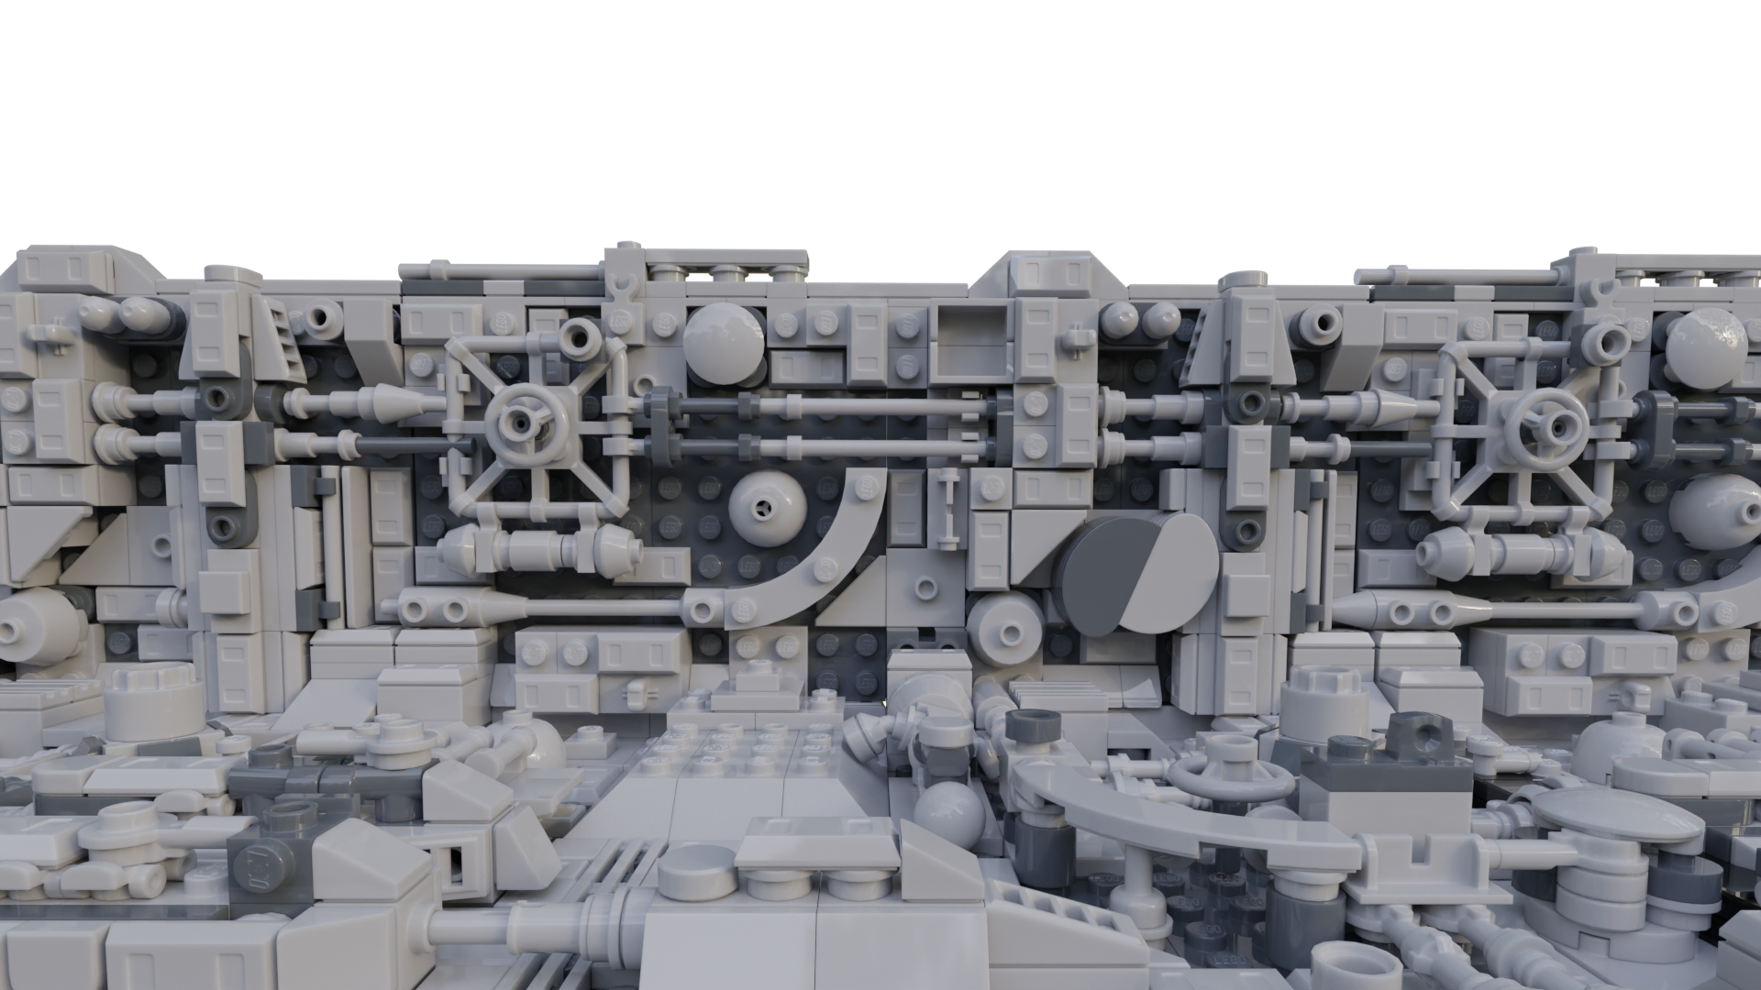
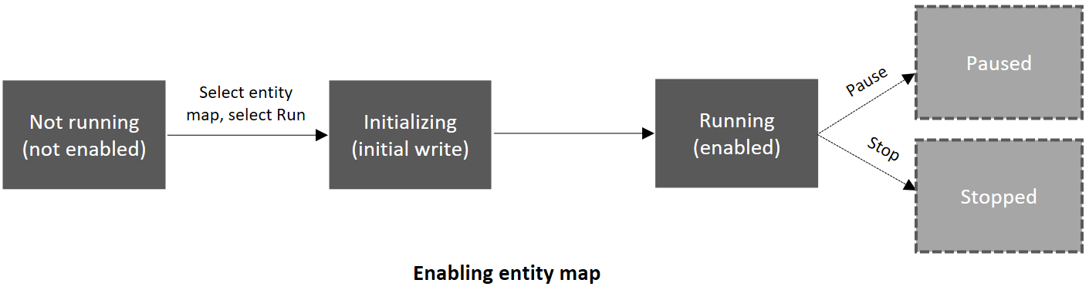


Slide 29
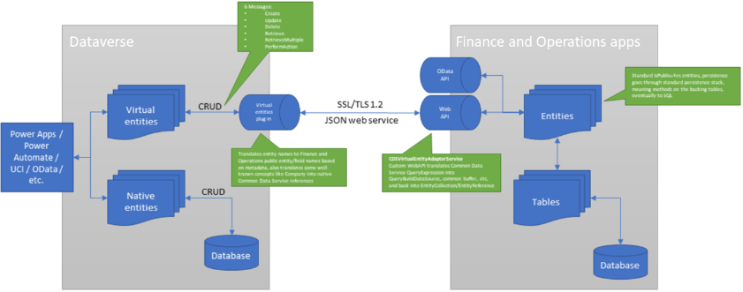
Virtual Entities
Reference: Virtual entities overview - Finance & Operations | Dynamics 365 | Microsoft Learn
Notes:
Virtual entities are a Dataverse concept that is useful beyond finance and operations apps.
CRUD operations: Create, Update, Delete, Retrieve, and RetrieveMultiple.

Slide 30
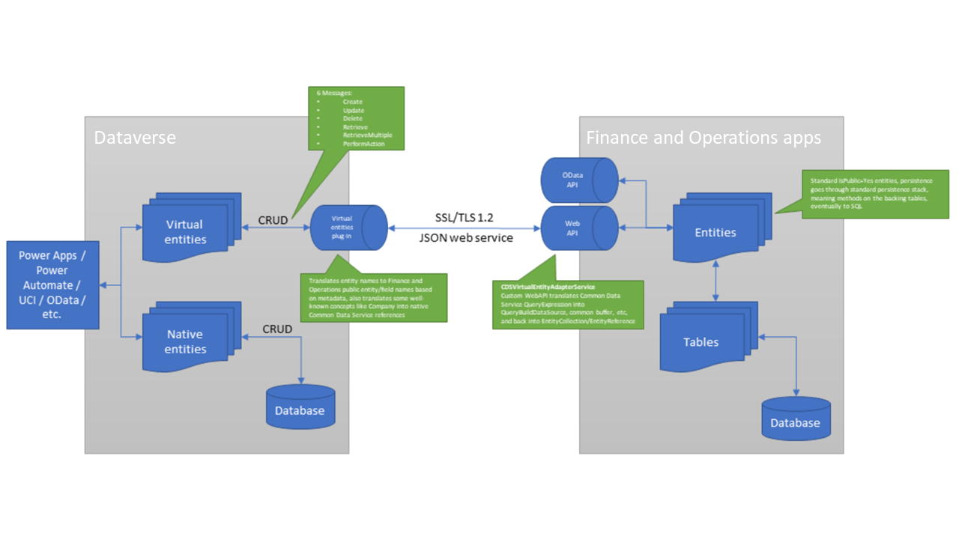

Slide 31

Q & A

Slide 32
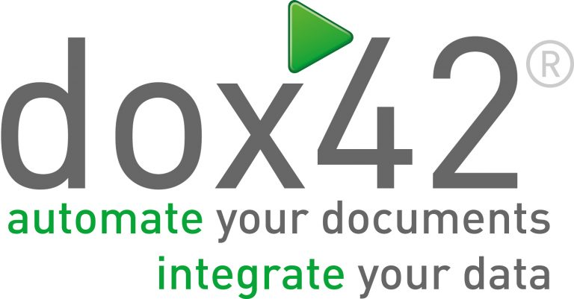




Sponsors
THANK
YOU!

